Slide 1
Jeremy Draws a Monster
Shapes
An Art Start Lesson: Kindergarten

Slide 2
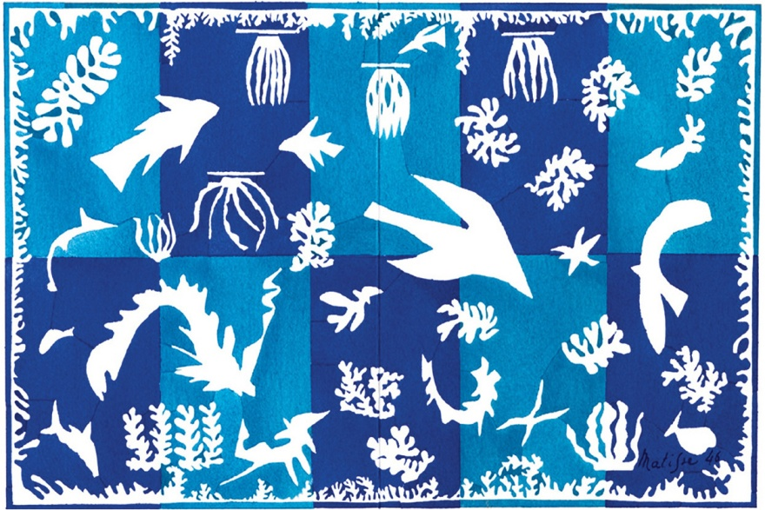
Shape:
art element that uses lines or color to create an enclosed space
Two Types of Shapes
Organic
Free form & curved
What type of shapes are organic?
Geometric
Precise and regular
What type of shapes are geometric?
Notes:
Point out the different geometric shapes that are very recognizable to the kids. Then show how the organic shapes can take any form so long as they are a closed area.

Slide 3
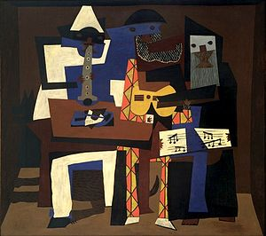
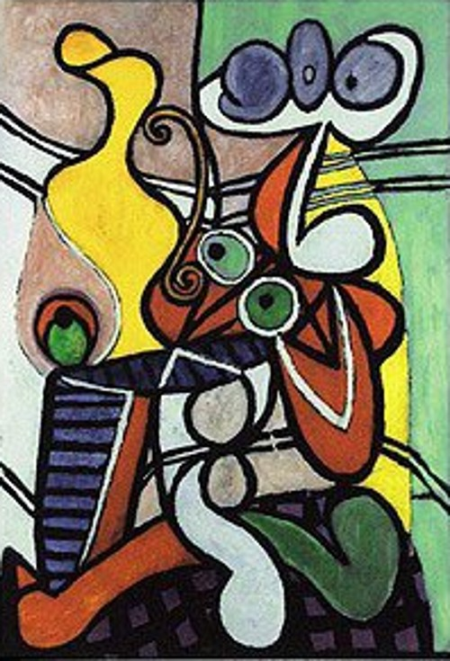
Geometric
Organic
Pablo Picasso
“Three Musicians”, 1921
Pablo Picasso
“Large Still Life with a Pedestal Table”, 1931
Notes:
Show how the three musicians has many geometric shapes and that large still has many curvy free flowing shapes. Ask the kids what they think about the two pieces. Are they Silly? Weird? What is their favorite part? Can they tell what the painting are of.

Slide 4
Pablo Picasso
* Pablo Picasso was born on October 25, 1881 in Spain. Very young Pablo showed an interest in drawing. His first words were "piz, piz", which is short for "lapiz", the Spanish word for pencil.
* Picasso finished his first painting at age 9
* At 13 he Picasso went to a Top art school but the teachers wanted him to paint their way not his. So he left.
* Picasso moved to Paris and helped start a new type of art called cubism, a type of art that used geometric shapes, and became one of the most famous painters in the world.
Notes:
Discuss Picasso

Slide 5
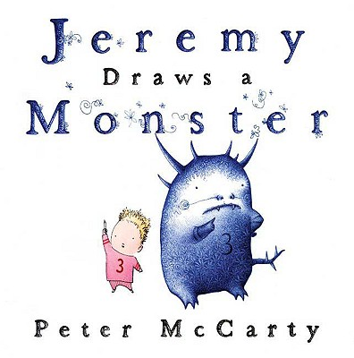
Notes:
Tell the kids before we start out project today I want to Read the book called Jeremy draws a monster. Feel free to coordinate with me to borrow if you can’t find it. 425-223-8324

Slide 6
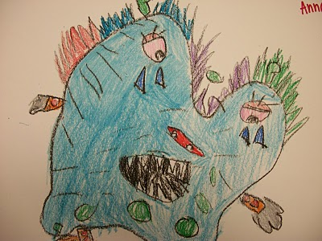
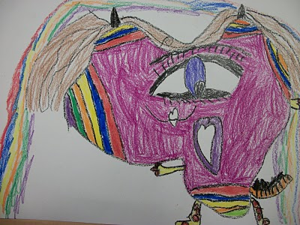
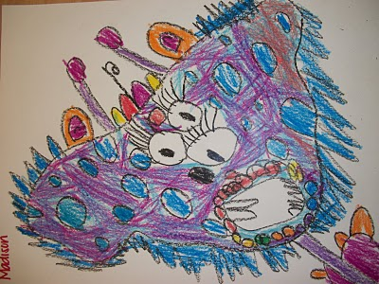
Monster Picasso
Notes:
Examples of what kids will make. Ask the kids what kind of Picasso monster they will be making? Happy, sad, mad, friendly, etc. Instruct them to use all their shapes. Geometric as well as organic.

Slide 7
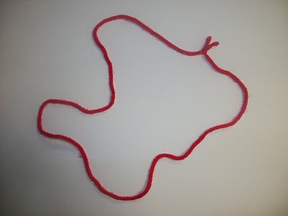
Notes:
give each of them a piece of string and practice making ORGANIC shapes with it. Then have them choose a shape to work with

Slide 8
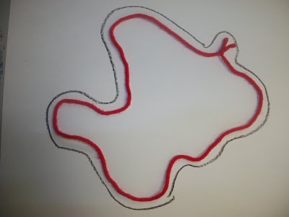
Notes:
Instruct each kids to trace around the outside of their yarn shape. This will be the monster body

Slide 9
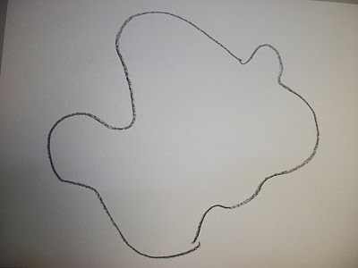
Notes:
discuss the elements that will make up our monster: will he be mean, nice, silly, scary, or happy? How do we make a scary mouth? What do silly eyes look like? also have each student make up a pattern on the monster's skin. This is good because many of them will just scribble over the whole thing green

Slide 10
What will
your
monster look like?

Slide 11
My Monster
My monsters name is…
My monster eats…
My monster lives in…
My monster likes to play…
My monster is good at…

